Slide 1
Modular Design and Coordination of Computer-Controlled Characters in Games
Thesis Defense – Computer Science Department, University of Antwerp
Khemin Van Gestelen
June 26th, 2025
Promotor: Prof. Hans Vangheluwe – Co-promotor: Prof. Clark Verbrugge – Advisor: Joeri Exelmans

Slide 2
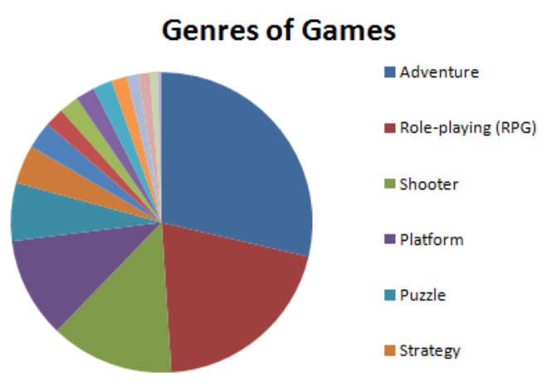
Motivation
The need for believable NPCs
Popular game genres
Team-based game
Autonomy and Coordination
[1]
[1] A. A. Qaffas, “An operational study of video games’ genres,” International Journal of Interactive Mobile Technologies (iJIM), vol. 14, no. 15, pp. 175–194, 2020.

Slide 3
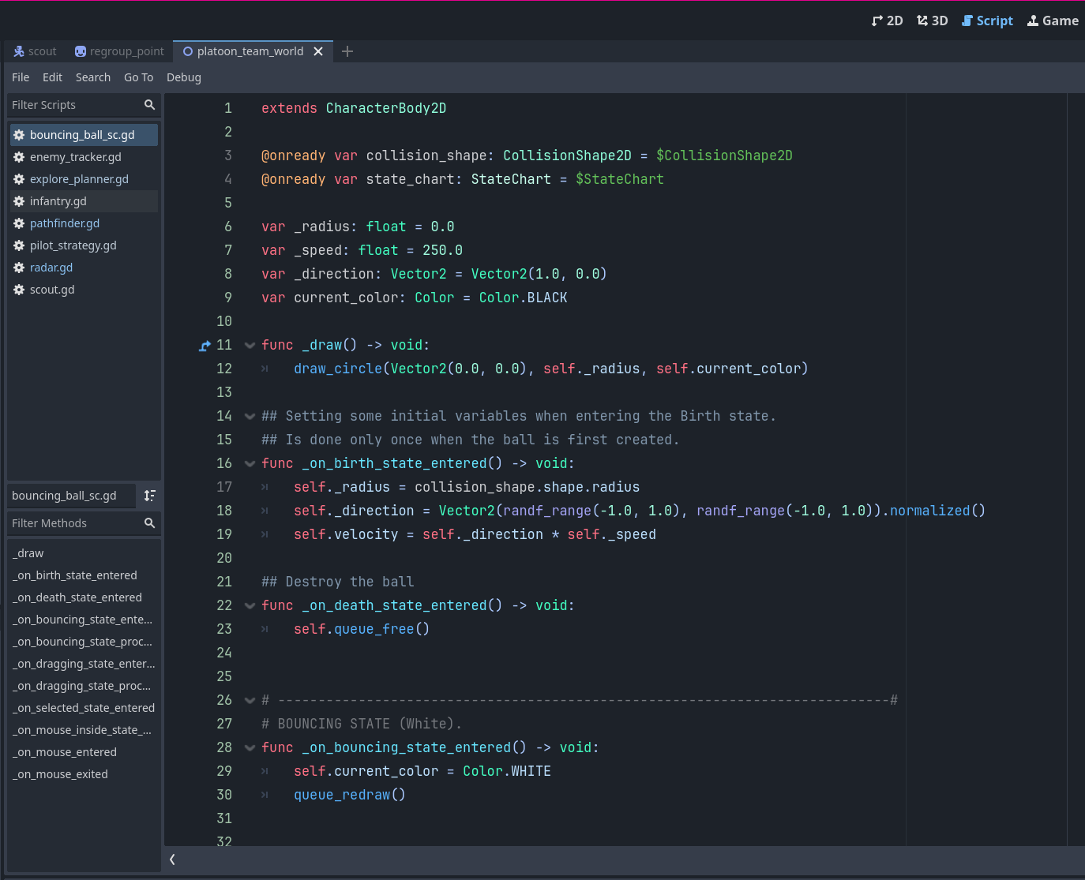
The Godot engine
Nodes
Scenes
SceneTree
Behavior through code
GDScript

Slide 4
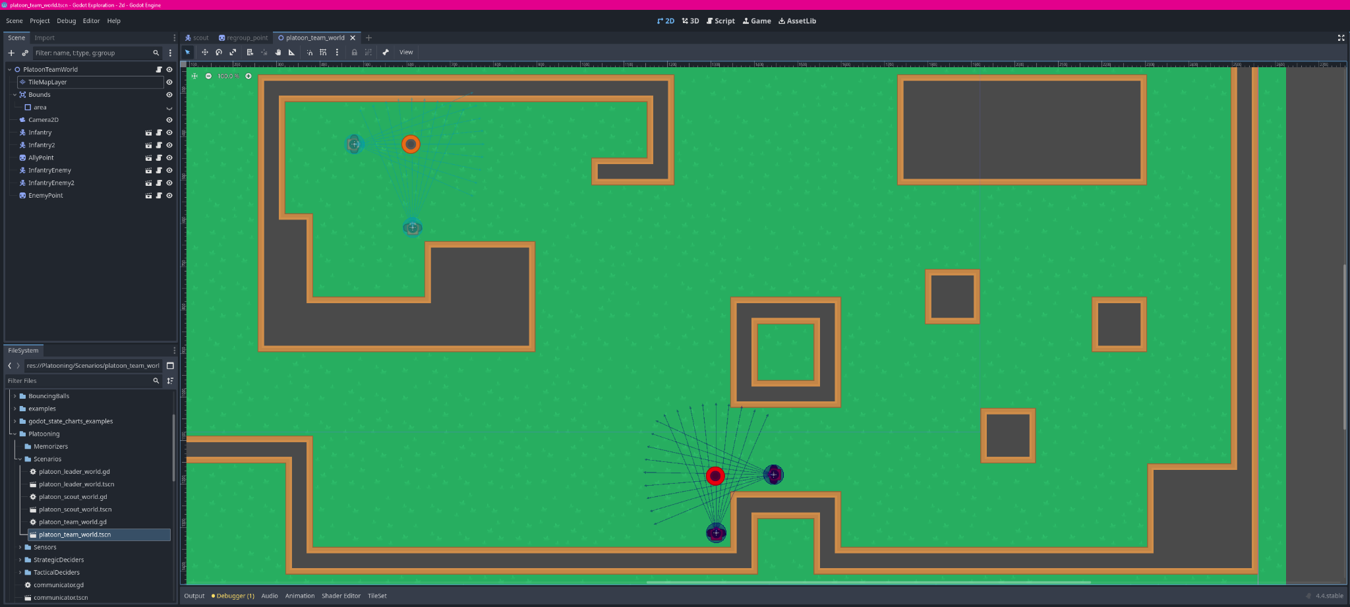

Slide 5
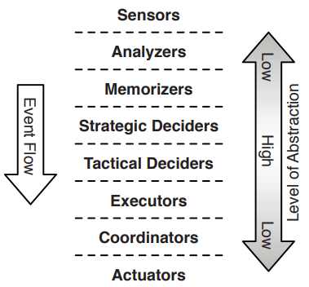
Modular Design
Understandability
Reusability
Godot’s modularity
Appropriate formalism
Inspiration for approach
Model-based design of computer-controlled game character behavior [2]
Reusable components for artificial intelligence in computer games [3]
[2]
[2] J. Kienzle, A. Denault, and H. Vangheluwe, “Model-based design of computer-controlled game character behavior,” MoDELS 2007, LNCS 4735, pp. 650––665, 2007.
[3] C. Dragert, J. Kienzle, and C. Verbrugge, “Reusable components for artificial intelligence in computer games,” GAS, pp. 35–41, 2012.

Slide 6
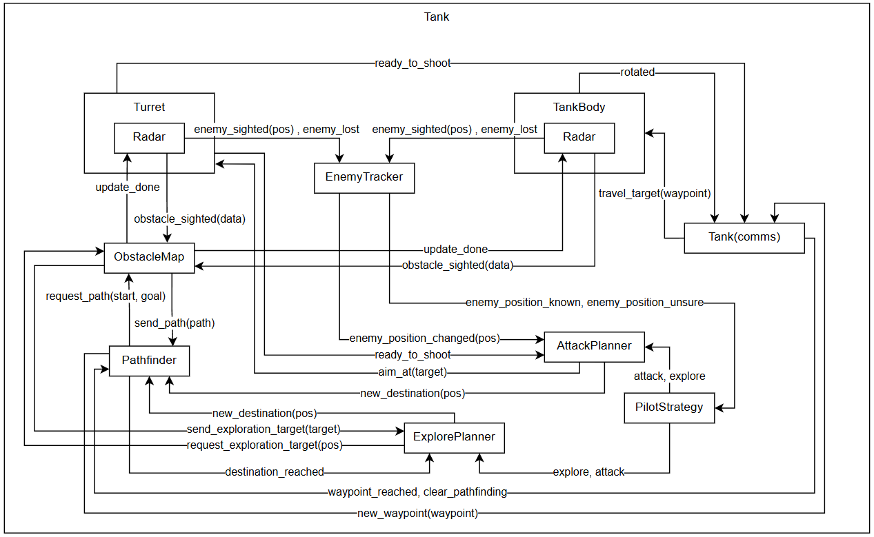

Slide 7
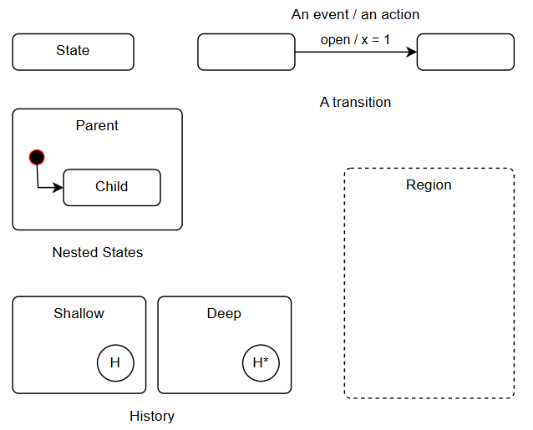
Statecharts
Finite State Machines
Hierarchy
Concurrency
Timed behavior
History

Slide 8
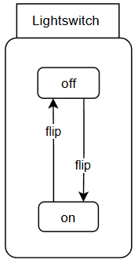
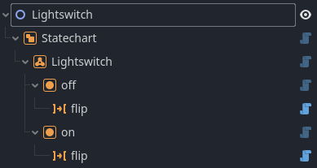
Statecharts in Godot
Godot Statechart Extension
developed by Godot community developer

Slide 9
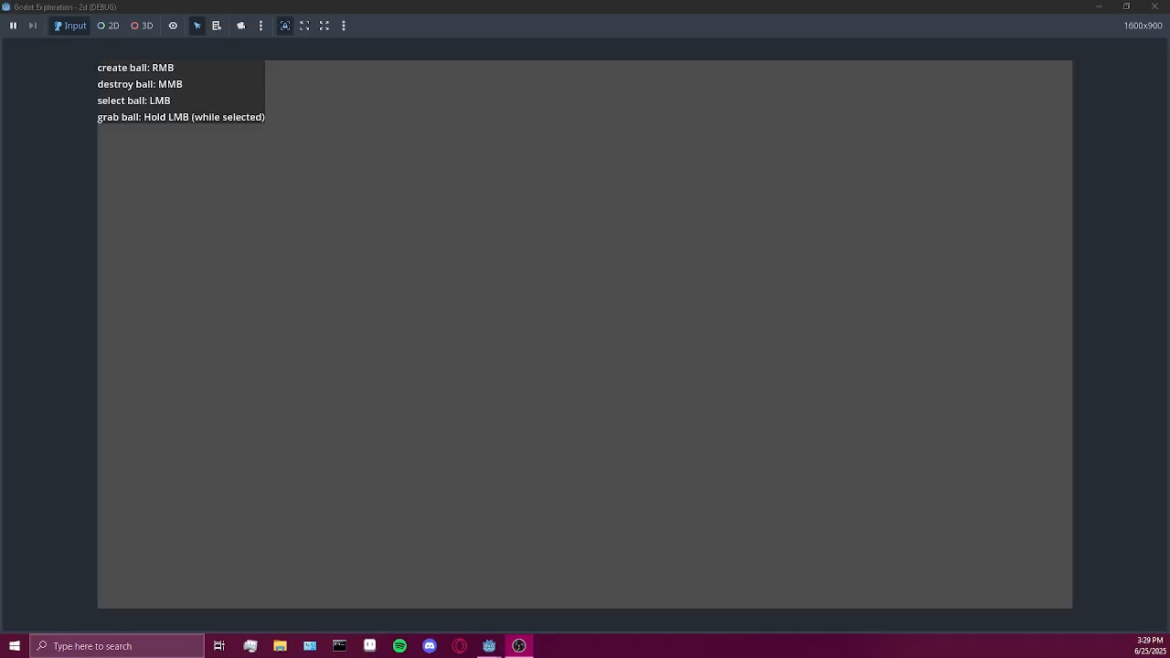
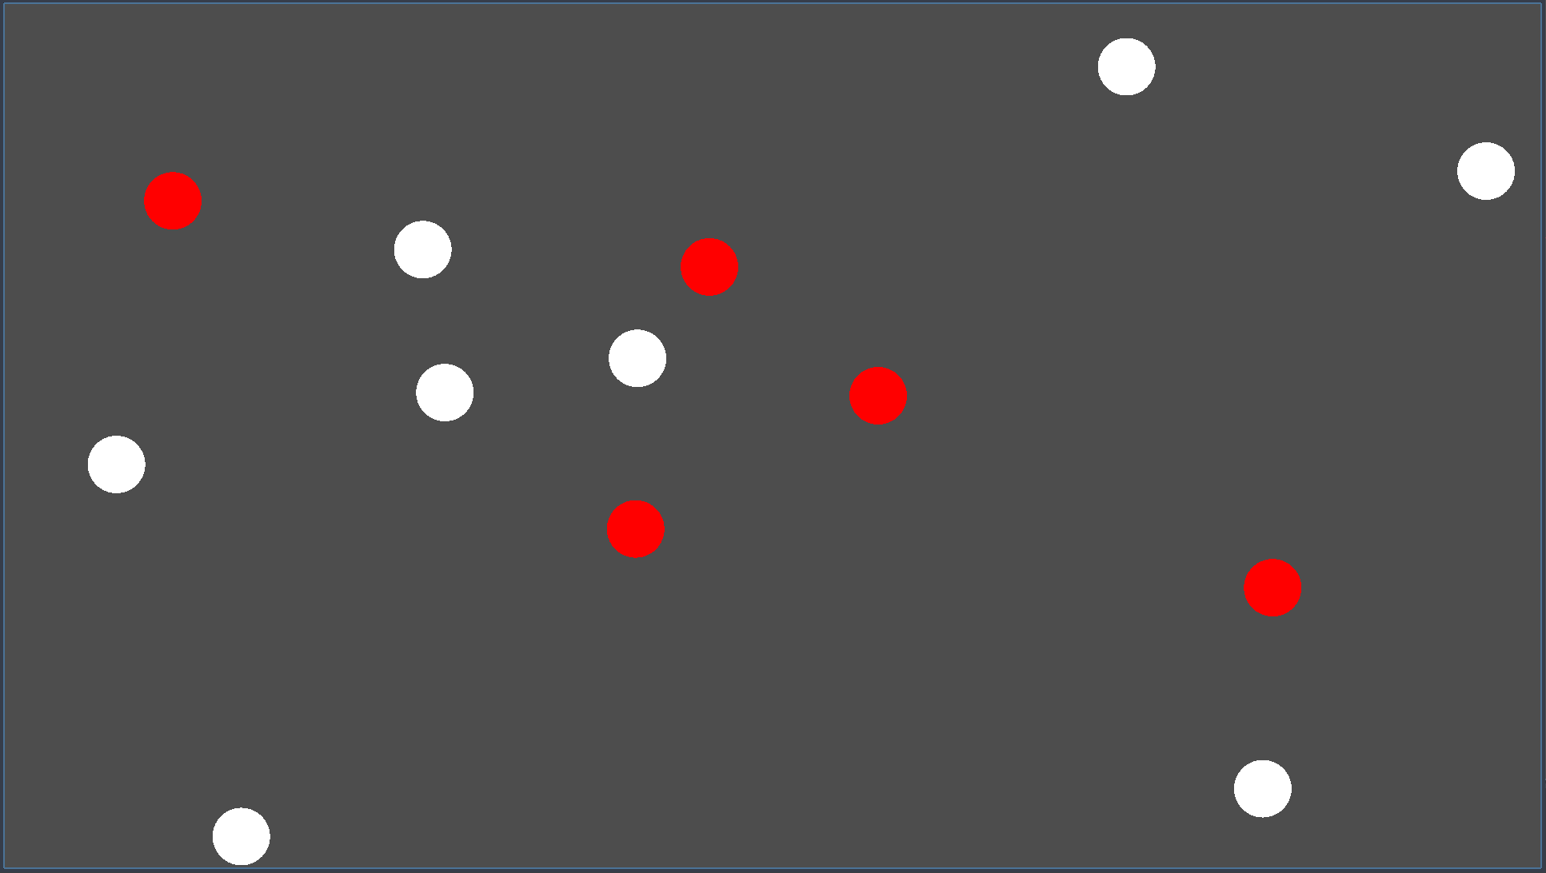
Bouncing Ball Demo

Slide 10
Semantic analysis
Limited documentation
Testing statechart [4]
Orthogonal regions testing different semantics
Additional small tests
[4] J. Exelmans, S. Van Mierlo, and H. Vangheluwe, “A statecharts interpreter and compiler with semantic variability,” MODELS ’22: Proceedings of the 25th International Conference on Model Driven Engineering Languages and Systems: Companion Proceedings, pp. 722–727, 2022.

Slide 11
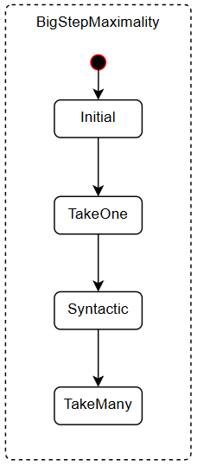
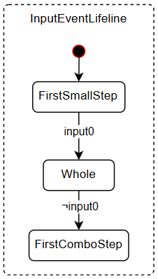
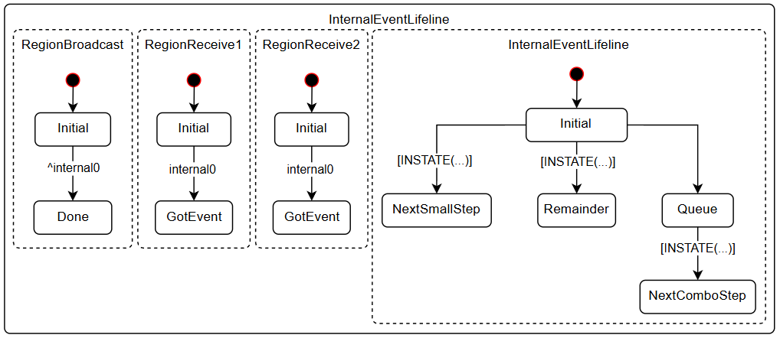

Slide 12
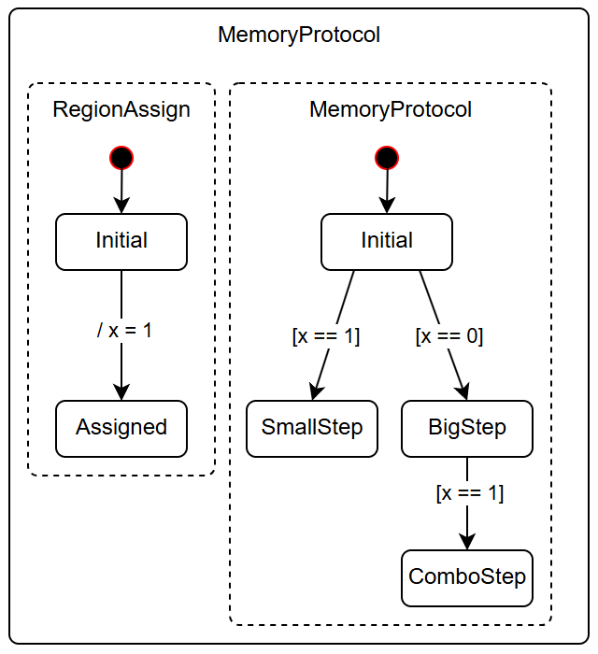
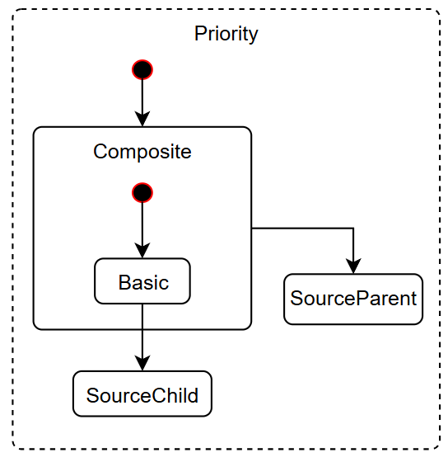

Slide 13
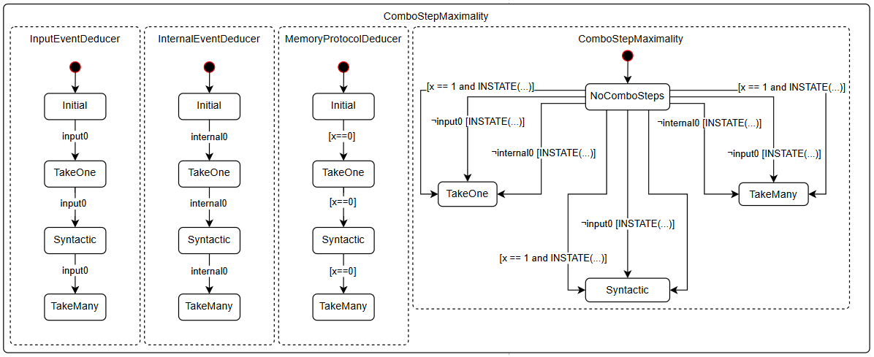

Slide 14
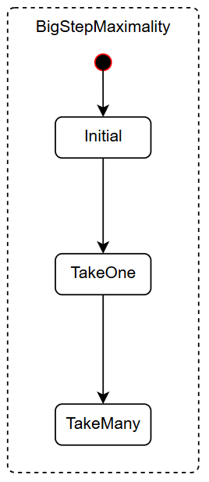
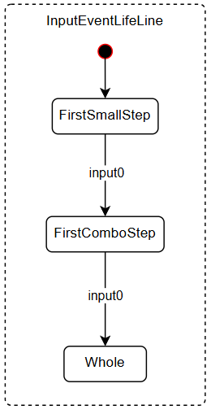
Alterations

Slide 15

Semantic results
Transition semantics
Event lifetime
Combo-Step

Slide 16
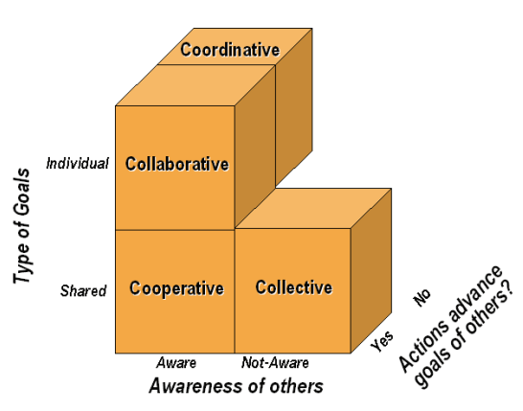
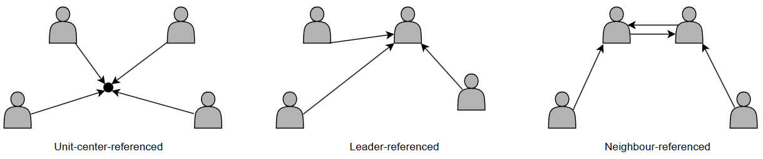
Coordination and Communication
Distributed Intelligence [5]
Formation Control [6]
[5]
[6]
[5] L. E. Parker, “Distributed intelligence: Overview of the field and its application in multi-robot systems,” Association for the Advancement of Artificial Intelligence, 2007.
[6] T. Balch and R. C. Arkin, “Behavior-based formation control for multirobot teams,” IEEE Transactions on Robotics and Automation, vol. 14, no. 6, pp. 926–939, 1998.

Slide 17
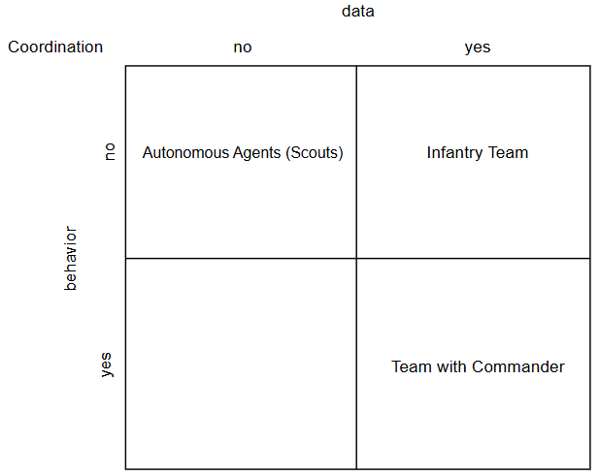
Practical Experiments
Interaction
Coordination and communication

Slide 18
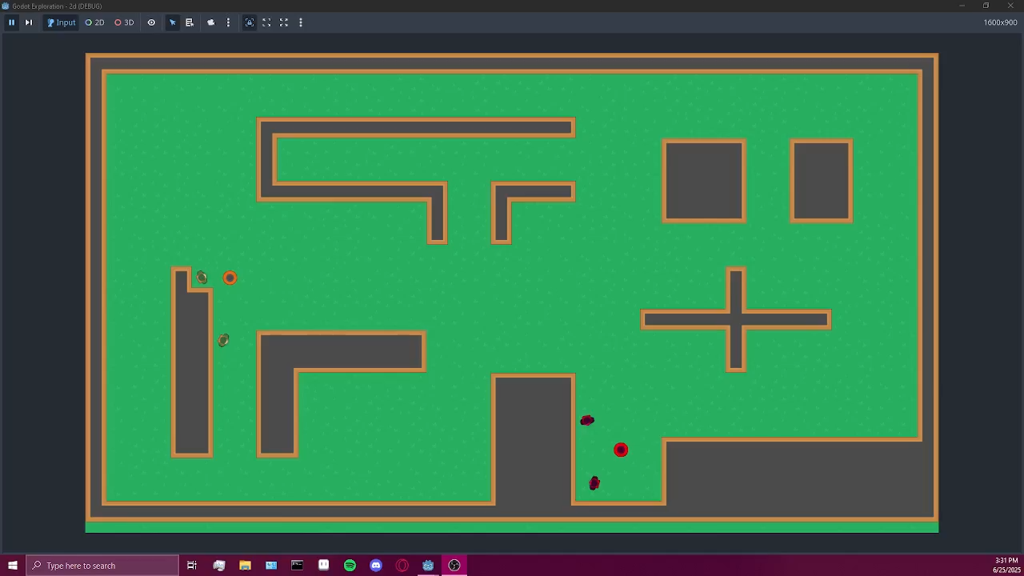
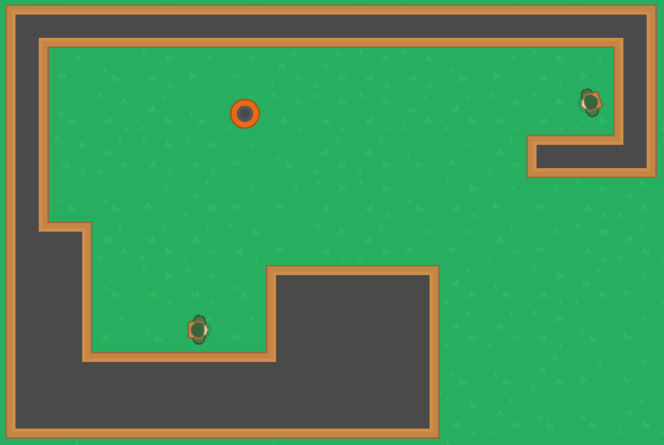
Coordination Experiments Demos

Slide 19
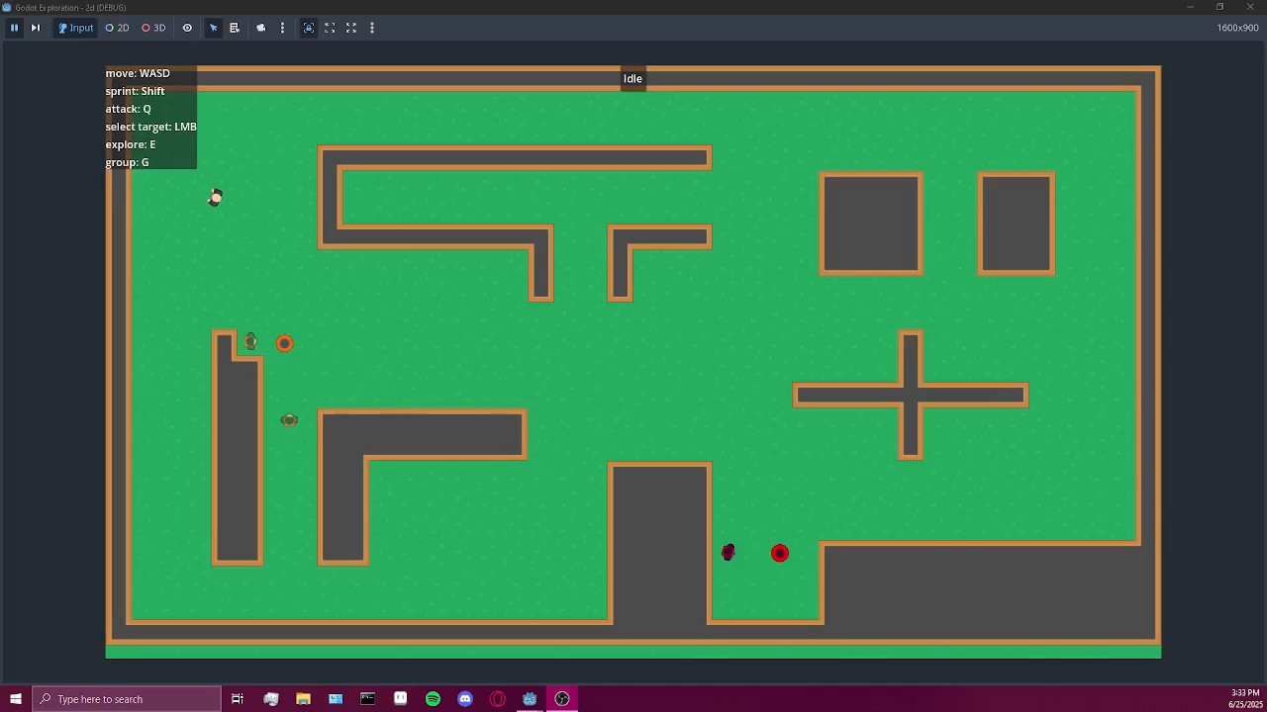

Slide 20
Conclusion
Modular design
Communicating objects
behavior modelled with Statecharts
Non-player characters in a game
Contributions
Semantic analysis
Exploration of modular design in the Godot engine

Slide 21
Future Work
Evaluation – parameterization
playability (include human player)
Coordination
communication, formations, tactics
Coordination problems
friendly fire

